Slide 1
Hubble
Space Telescope
By - Karthick Js 23N221

Slide 2
Table of contents
INTRODUCTION
Exploring the Exoplanets
1
2
Universe Through Hubble
3
4
Dark matter
Introduction about the hubble telescope
How exoplanets are found by telescopes
How Hubble helped us to see the universe
Hubble role in finding the dark matter

Slide 3
1
Introduction
HUBBLE SPACE TELESCOPE

Slide 4
Introduction
Named After The Scientist Edwin Hubble.
Edwin Hubble is known for his great observation on galaxies.
Hubble Played a vital role in the exploration of the outer Space.
It has solved and created many mysterious of the space(including the dark matter and the age of the universe).

Slide 5
2
Exoplanets
Hubble in search of exoplanets

Slide 6
Exoplanets
In 2000, Hubble studied the exoplanets HD 209458b,
Light years away from us
It is the first exoplanet found to make transit across a star
Hubble studied the absorption spectrum of the planet
It found that there is Methane in the planet atmosphere.

Slide 7
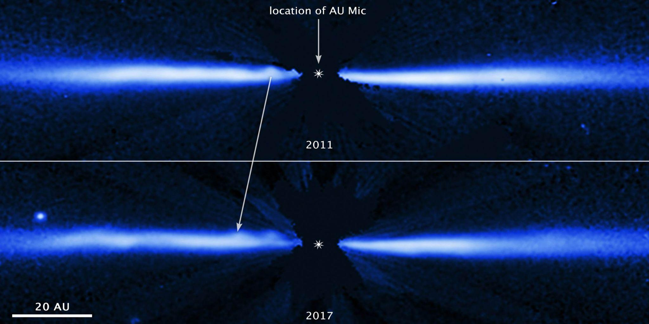
Hubble direct image of a stellar cloud around a star(AU MIC) shows the data of how the planets are formed . The dot shows the small asteroids forming around the star that could seed into lifeless planets Just like how earth could have formed.

Slide 8
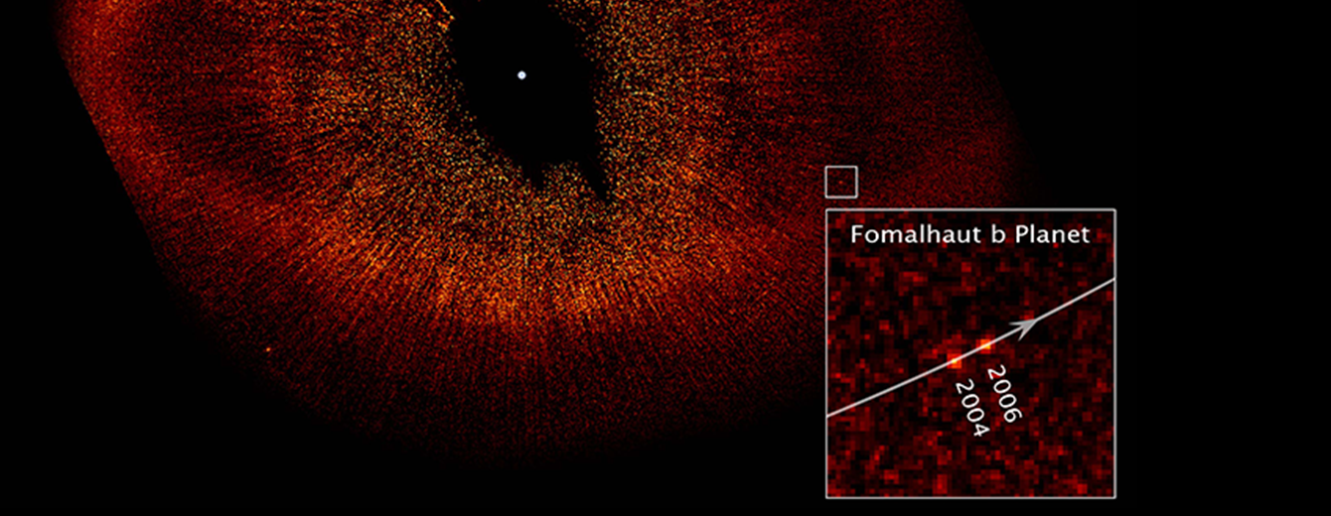
Hubble space telescope takes the first direct image of the exoplanet fomalhaut b orbiting around the star fomalhaut in a space debris of around 12.5 billion miles around the sun.
This is considered as one of key moments of exoplanet research as it gave a new way to find the exoplanets called as direct imaging is possible.

Slide 9
3
Universe through hubble
View of universe through hubble.

Slide 10
Universe through hubble telescope
Hubble played a key role in determining the age of the universe.
In 1929, Edwin hubble discovered galaxies moves away from us,and coined the redshift
This changed the view of astrophysics view of the universe.
Edwin Hubble deduced a constant known as hubble constant of the redshift and calculated the age of the universe.
But it failed as the distance value was not that accurate using the old instruments.

Slide 11
Universe through hubble telescope
Hubble helped to find out the precise value of the hubble constant.
By Hubble values The age of the universe is found out to be 13.8 Billion years.
However there is still a debate going on as The values arrived by the cosmic microwave background is slightly different from that of hubble value.

Slide 12
4
Dark matter
Hubble study of Dark Matter

Slide 13
DARK MATTER
In 2006, X-Chandra and Hubble first found out the traces of Dark Matter.
It was found at the galactic cluster as a mysterious particle holding up the galaxies in the cluster.
In 2004,Hubble found a image of the collision two galactic cluster which has a small ring like swelling which astrophysics term as dark matter ring
It is seen by the phenomenon of gravitational lensing.

Slide 14
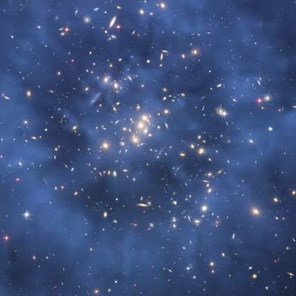
“ I was annoyed when I saw the ring because It was a great flaw in our data.I couldn’t believe my result. But The more I tried to remove the ring The more it appeared.It took more than a year to convince myself that the ring was real” – Jee(astrophysicist at NASA)

Slide 15
– Stephen Hawking
“We are just an advanced breed of monkeys on a minor planet on a very average star. But we can understand the universe . That makes us something special.”

Slide 16
Thanks for your patience listening

